Slide 1
Concolic Testing
Prof. Durga Prasad Mohapatra
Professor
Dept.of CSE, NIT Rourkela
.

Slide 2
Basic Concepts
The concept of CONCOLIC testing combines the CONCrete constraints execution and symbOLIC constraints execution to automatically generate test cases for full path coverage.
This testing strategy generates test suites by executing the program with random values.
At execution time both concrete and symbolic values are saved for execution path.
During execution, the variables are stored in some symbolic values such as x₀, and y₀, (i₀ and i₁) instead of x and y.
The next iteration of the process forces the selection of different paths.

Slide 3
Basic Concepts cont …
Concolic Testing
The tester selects a value from the path constraints and negates the values to create a new path value. Then the tester finds concrete constraints to satisfy the new path values.
The selection of values is performed by the Constraint Solver which is a part of Concolic Tester.
These constraints are inputs for all next executions. This concolic testing is performed iteratively until exceeds some threshold value or sufficient code coverage is obtained.

Slide 4
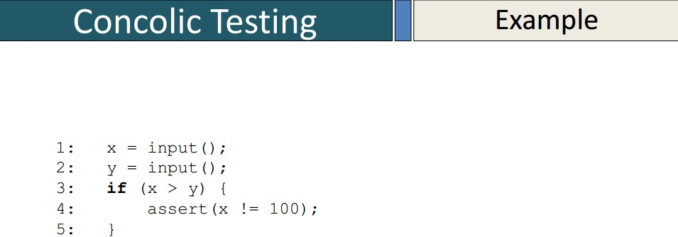
Concolic Testing Example

Slide 5
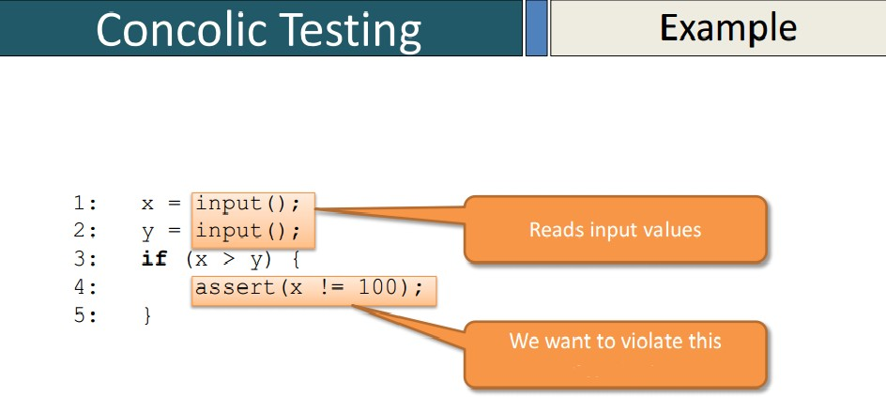
Concolic Testing Example cont …

Slide 6
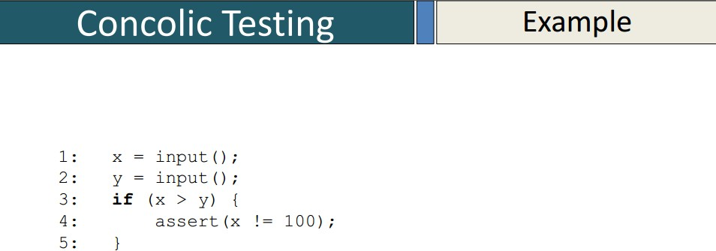
Concolic Testing Example cont …

Slide 7
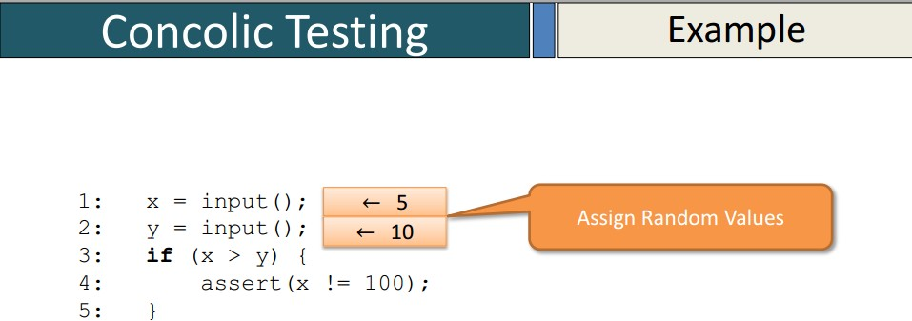
Concolic Testing Example cont …
21/35

Slide 8
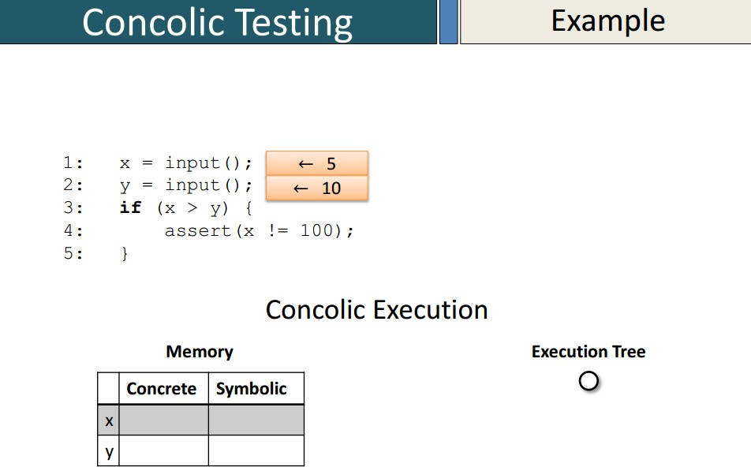
Concolic Testing Example cont …

Slide 9
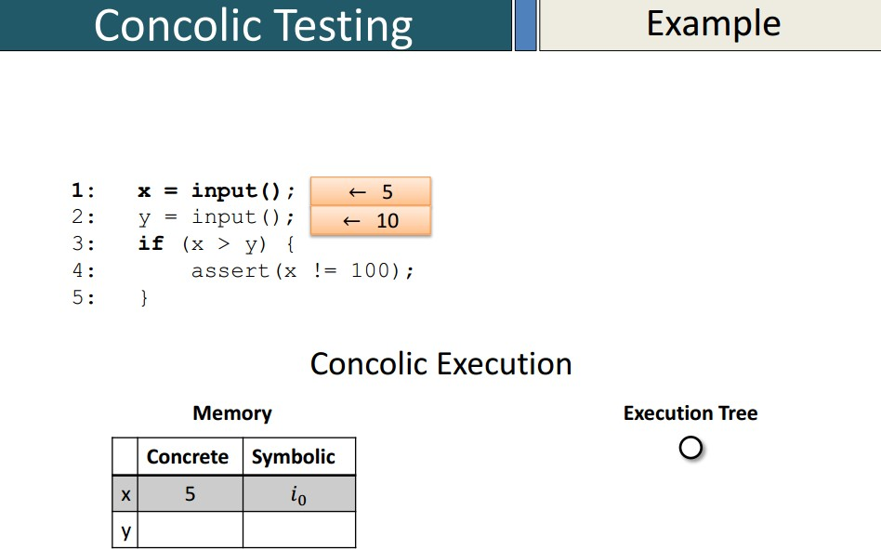
Concolic Testing Example cont …

Slide 10
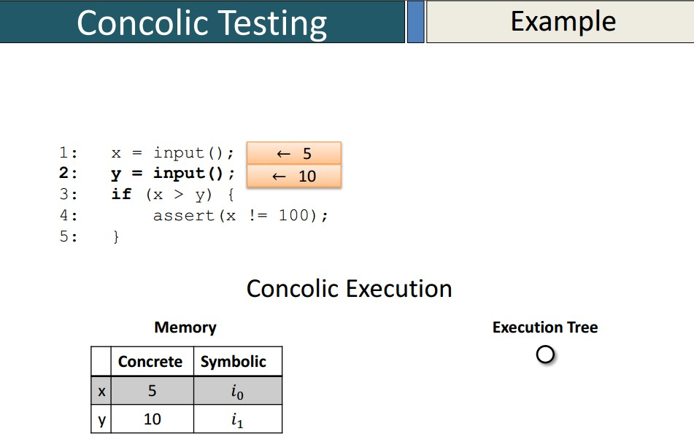
Concolic Testing Example cont …

Slide 11
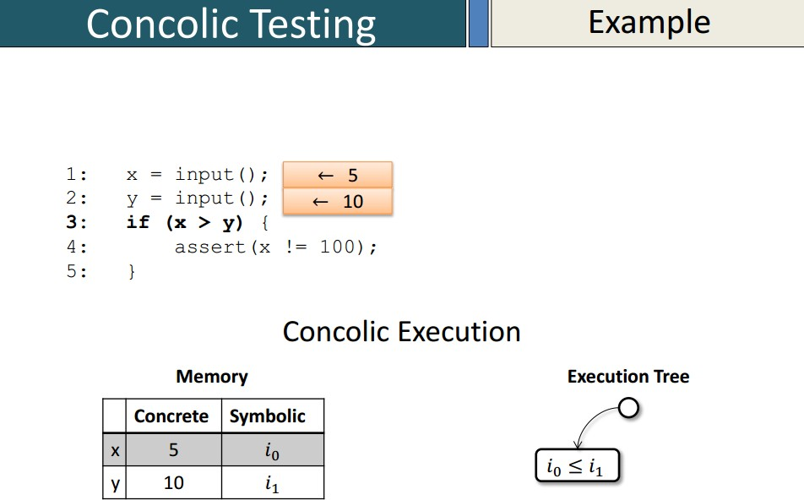
Concolic Testing Example cont …

Slide 12
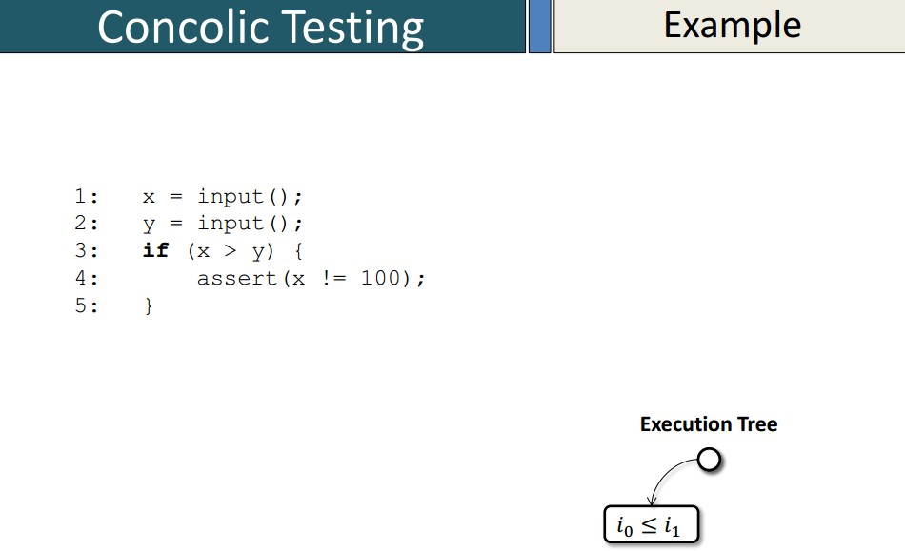
Concolic Testing Example cont …

Slide 13
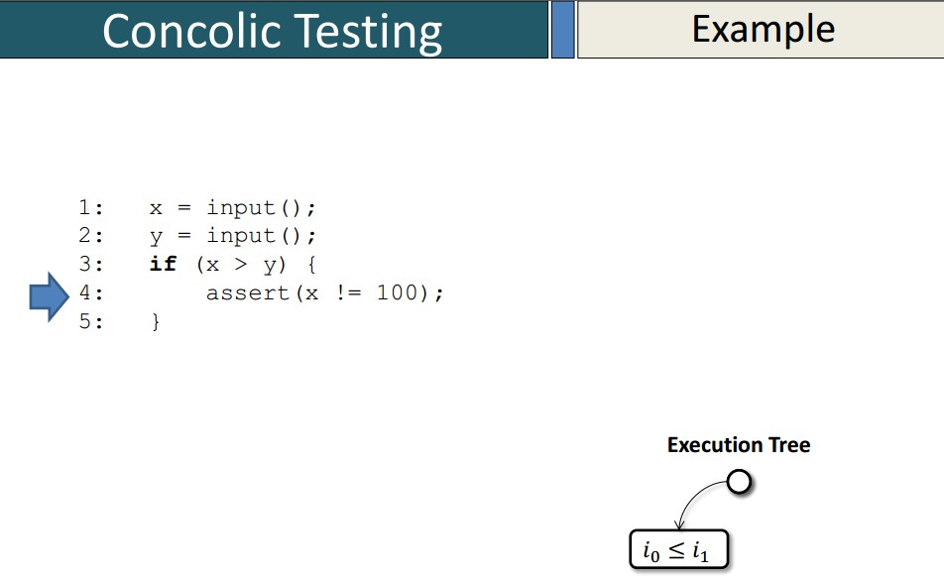
Concolic Testing Example cont …

Slide 14
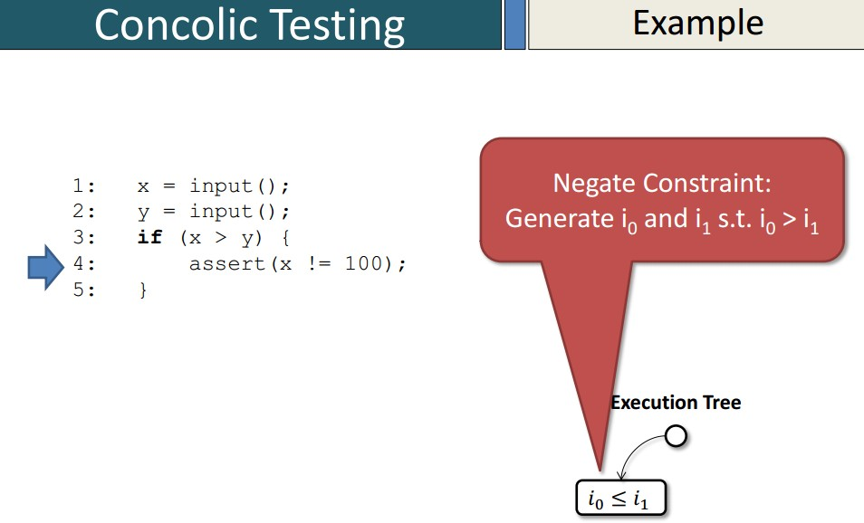
Concolic Testing Example cont …

Slide 15
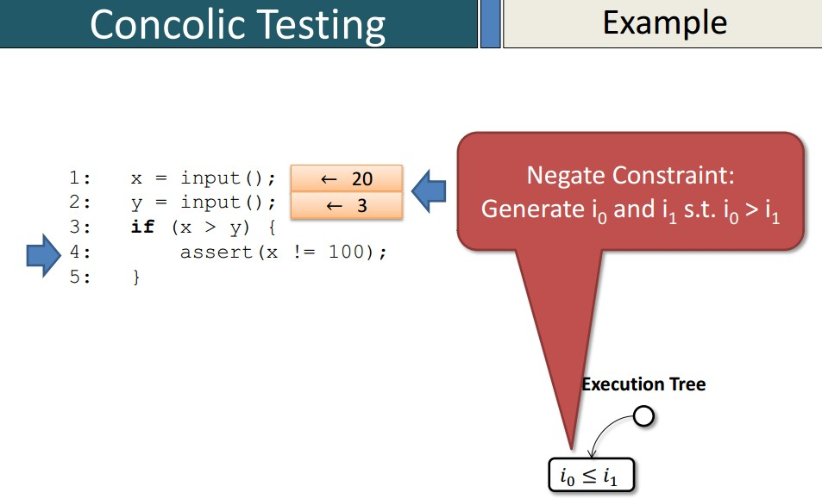
Concolic Testing Example cont …

Slide 16

Concolic Testing Example cont …

Slide 17

Concolic Testing Example cont …

Slide 18

Concolic Testing Example cont …

Slide 19
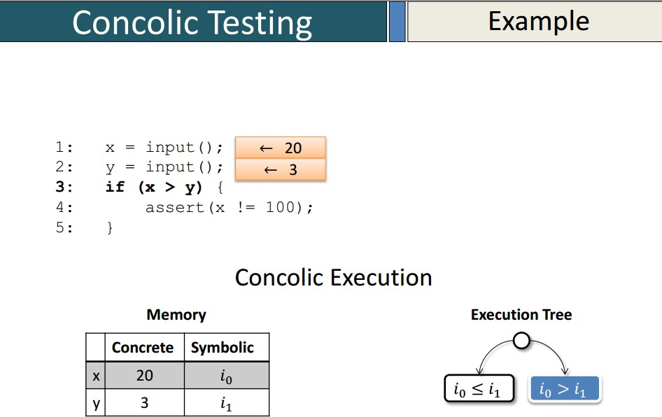
Concolic Testing Example cont …

Slide 20
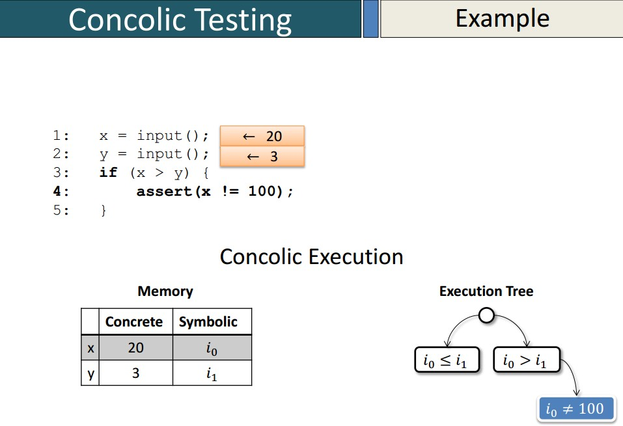
Concolic Testing Example cont …

Slide 21
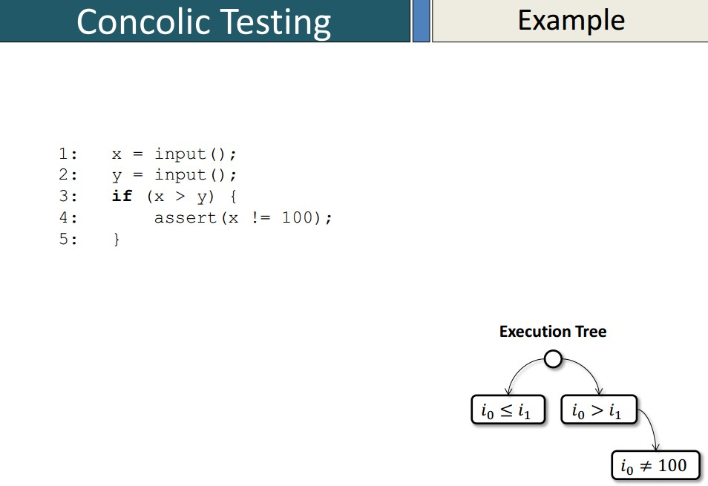
Concolic Testing Example cont …
21/35

Slide 22
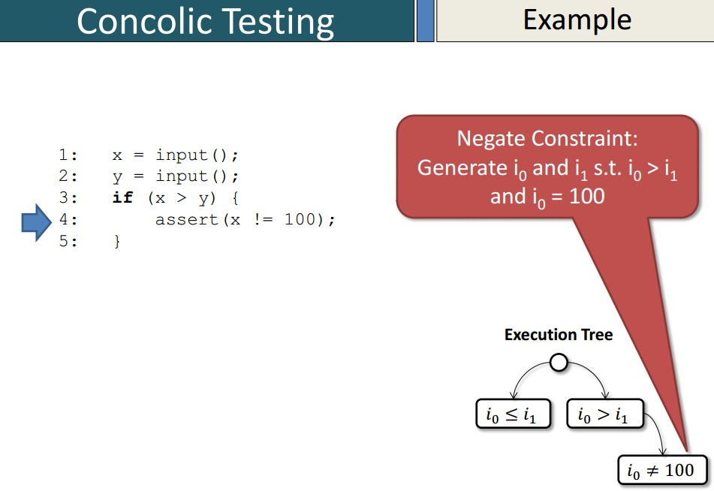
Concolic Testing Example cont …

Slide 23
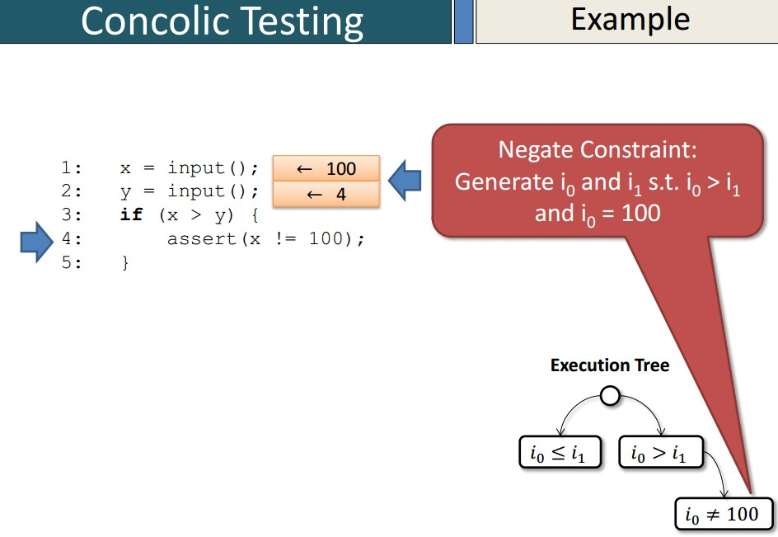
Concolic Testing Example cont …

Slide 24
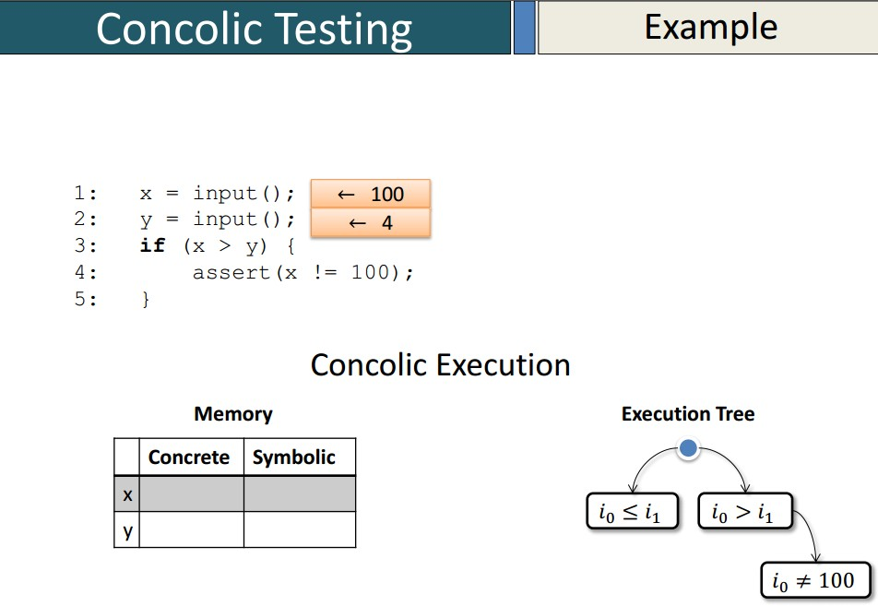
Concolic Testing Example cont …

Slide 25
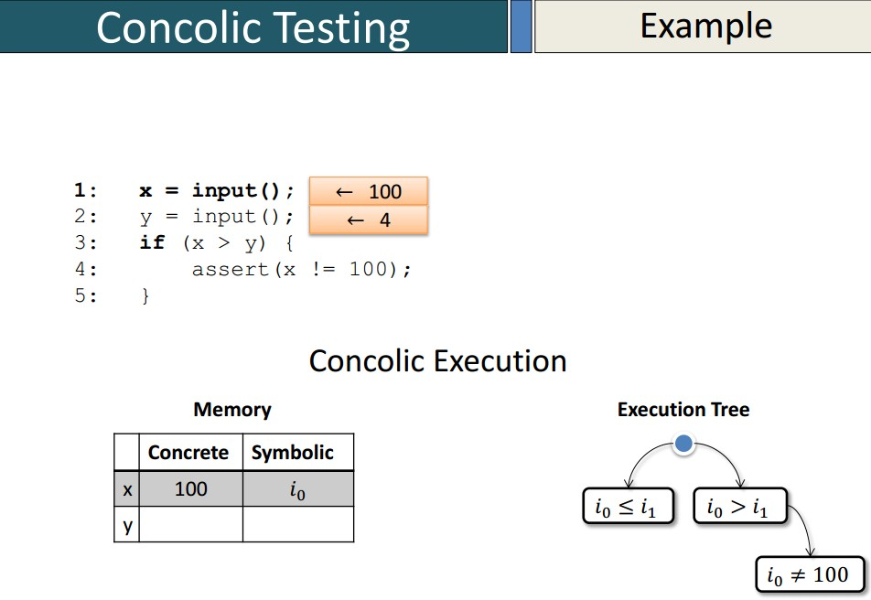
Concolic Testing Example cont …

Slide 26
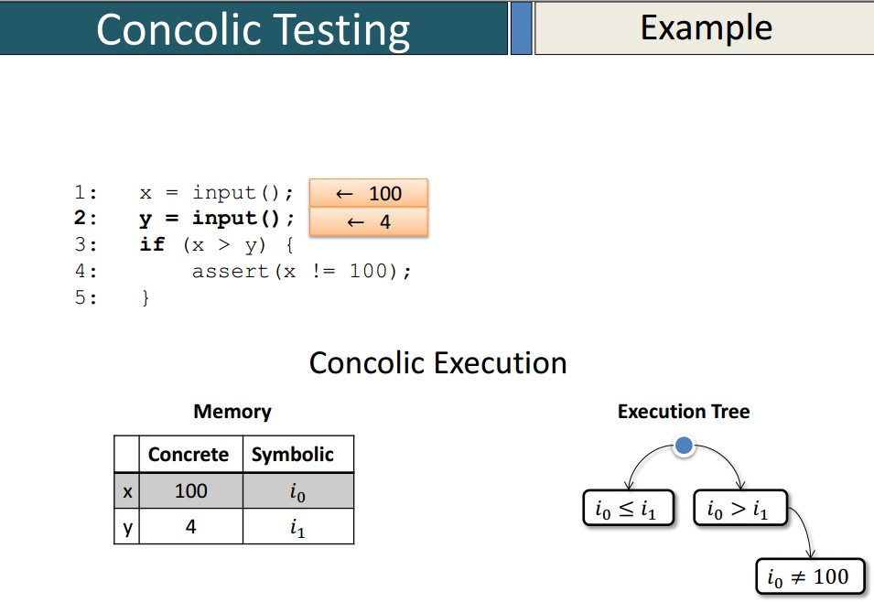
Concolic Testing Example cont …

Slide 27
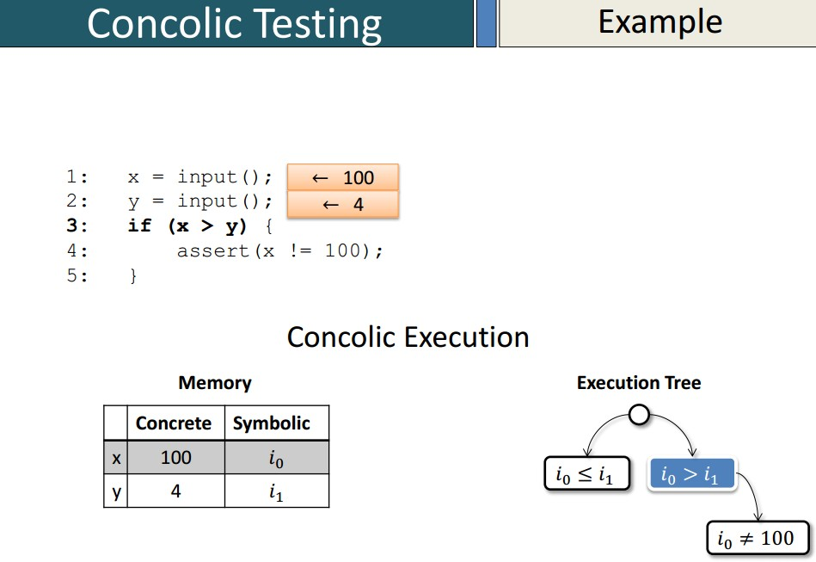
Concolic Testing Example cont …

Slide 28
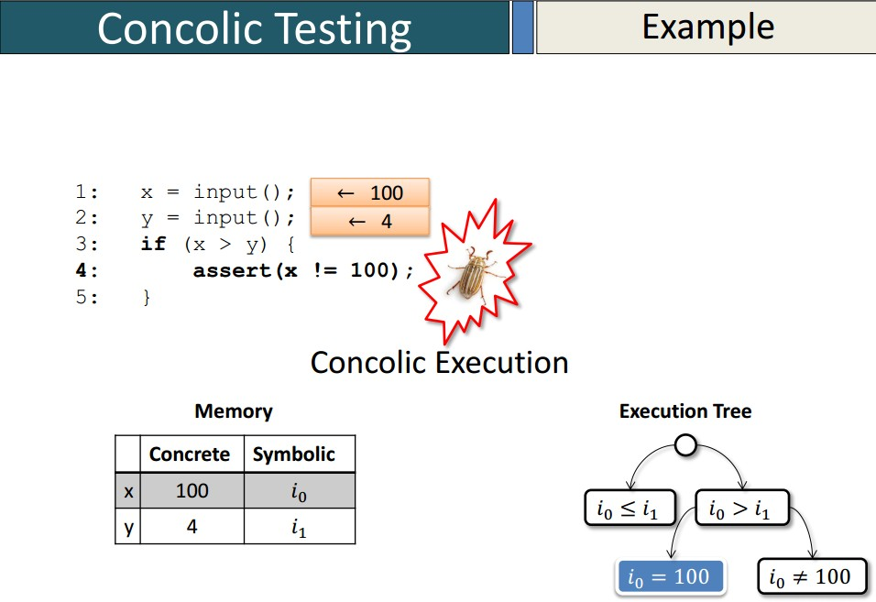
Concolic Testing Example cont …

Slide 29
Concolic Testing Example cont …
Concolic Testing: Final report
Concolic testing technique explored total 3 paths for the example program.
It has generated total three test cases for the variables x and y. These are shown in Table 1.
Table 1: Test cases generated by Concolic Tester
Test cases | TC1 | TC2 | TC3
x | 5 | 20 | 100
y | 10 | 3 | 4

Slide 30
Distributed Concolic Testing
Distributed Concolic Testing
Distributed Concolic Testing (DCT) is an extension of the original concolic testing approach that uses several computing nodes in a distributed manner.
It significantly reduces the time to generate test cases with better efficiency.
Concolic testing is the combination of concrete and symbolic testing. In addition, distributed concolic testing is scalable and achieves a linear speedup by using a large number of computing nodes for test case generation.

Slide 31
Concolic Testing Tools
In Table 2, we have compared concolic testing tools with respect to the following parameters/features: 1) variables types; 2) pointers; 3) native calls; 4) non-linear arithmetic operations; 5) bitwise operations; 6) array offsets and 7) function pointers.
The abbreviation used in Table 2 are the following: “Y” means the tool supports the feature. “N” means the tool does not support the feature.“P”means the tool can partially support the feature. “NA”means unknown.

Slide 32
Concolic Testing Tools
Table 2: Summary of concolic tester with their properties.
Tool Name | Supporting Language | Supporting Platform | Support Constraints Solver | Support for float/double | Support for Pointer | Support for native call | Support for non-linear arithmetic op. | Support for bitwise op. | Support for Offset | Support for function pointer
DART | C | NA | LP SOLVER | N | N | N | NA | NA | N | N
SMART | C | LINUX | LP SOLVER | N | N | N | NA | NA | N | N
CUTE | C | LINUX | LP SOLVER | N | Y | N | NA | NA | N | N
jCUTE | JAVA | LINUX/WINDOWS | NA | N | - | N | NA | NA | N | N
CREST | C | LINUX | YICES | N | N | N | P | P | N | N
EXE | C | LINUX | STP | N | Y | N | Y | Y | Y | N
KLEE | C | LINUX | STP | N | Y | P | Y | Y | Y | NA
RWSET | C | LINUX | STP | N | Y | N | Y | Y | Y | NA
jFUZZ | JAVA | LINUX | BUILT ON JPF | N | NA | N | N | N | NA | NA
PATH CRAWLER | C | NA | NA | NA | NA | N | NA | NA | NA | NA
PEX | .NET | WINDOWS | Z3 | N | NA | N | NA | NA | NA | NA
SAGE | MACHINE CODE | WINDOWS | DISOLVER | NA | N | Y | NA | NA | NA | NA
APOLLO | PHP | WINDOWS | CHOCO | NA | NA | N | NA | N | NA | NA
SCORE | C | LINIX | Z3 SMT Solver | Y | N | N | Y | N | NA | NA

Slide 33
jCUTE
Distributed Concolic Testing
jCUTE, the Concolic Unit Testing Engine for Java (JCUTE), consists of two main modules: an instrumentation module and a library to perform symbolic execution.
These modules support to solve constraints, and to control the thread schedules.
The instrumental program calls the library at runtime for performing the symbolic execution.
JCUTE uses CIL and the SOOT compiler framework to instrument Java programs.

Slide 34
jCUTE
Distributed Concolic Testing
Instrumentation of JCUTE associates a semaphore with each thread and adds operation on these semaphores before each shared-memory access.
To solve arithmetic inequalities, a library for integer linear programming is provided.
JCUTE saves all the generated inputs and the schedules in the file-system.
For sequential programs, JCUTE generates Junit test cases and also allows the user to graphically visualize the multi-threaded execution.

Slide 35
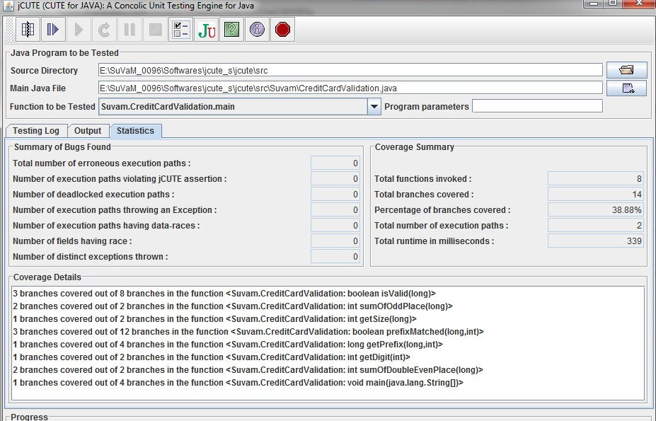
jCUTE screen shot

Slide 36
References
1
Palacios, M., Garc´ıa-Fanjul, J., Tuya, J. and Spanoudakis, G., 2015. Coverage-based testing for service level agreements. IEEE Transactions on Services Computing, 8(2), pages 299-313.
2
Fraser, G. and Arcuri, A., 2014. A large-scale evaluation of automated unit test generation using EvoSuite. ACM Transactions on Software Engineering and Methodology (TOSEM), 24(2), page 8.
3
Jones, JA. and Harrold, MJ. 2013. Test-suite reduction and prioritization for modified condition/decision coverage. IEEE Transactions on Software Engineering. 29(3), pages 195-209.
4
Baluda, M., Braione, P., Denaro, G. and Pezz`e, M., 2011. Enhancing structural software coverage by incrementally computing branch executability. Software Quality Journal, 19(4), pages 725-751.

Slide 37
References
5
Jiang B, Tse TH, Grieskamp W, Kicillof N, Cao Y, Li X, Chan WK. 2011. Assuring the model evolution of protocol software specifications by regression testing process improvement. Software: Practice and Experience. 41(10). pages 1073-1103.
6 McMinn, P. 2004. Search-based software test data generation: a survey: Research articles. Software Testing, Verification and Reliability, 14(2), pages 105–156.
7
Harman M., Hu L., Hierons R., Wegener J., Sthamer H., Baresel A., and Roper M., 2004. Testability Transformation. IEEE TRANSACTIONS ON SOFTWARE ENGINEERING, 30(1), pages 1-14.
8
Wegener, J., Baresel, A. and Sthamer, H., 2001. Evolutionary test environment for automatic structural testing. Information and Software Technology, 43(14), pages 841-854.
9 Duran, J.W. and Ntafos, S.C., 1984. An evaluation of random testing. IEEE transactions on software engineering, (4), pages 438-444.

Slide 38
References
10 Miller, W., and Spooner, DL. 1976. Automatic generation of floating-point test data. IEEE Transactions on Software Engineering, 2(3):223-226.
11 Kuhn, DR. 1999. Fault classes and error detection capability of specification-based testing. ACM Transactions on Software Engineering Methodology, 8(4), pages 411-424.
12 Ferguson, R. and Korel, B., 1996. The chaining approach for software test data generation. ACM Transactions on Software Engineering and Methodology (TOSEM), 5(1), pages. 63-86.
13 DeMillo, R., and Offutt, J., 1993. Experimental results from an Automatic Test Case Generation. ACM Transaction on Software Engineering Methodology, 2(2), pages 109-175.
14 Ntafos, S.C., 1988. A comparison of some structural testing strategies. IEEE Transactions on software engineering, 14(6), pages 868-874.
15 Chilenski, J., and Miller. S. 1994 Application of Modified Condition/Decision Coverage to Software Testing. Software Engineering Journal, pages 193-200.

Slide 39
References
16 Das A., and Mall R., 2013. Automatic Generation of MC/DC Test Data.
International Journal of Software Engineering, Acta Press 2(1).
17 Majumder R., and Sen K., 2007. Hybrid Concolic Testing. Proceedings of the 29th International Conference on Software Engineering,IEEE Computer Society,Washington, DC, USA pages 416-426.
18 Hayhurst, KJ., Veerhusen DS., Chilenski, JJ., Rierson, LK. 2001. A Practical Tutorial on Modified Condition/Decision Coverage, NASA/TM-2001-210876.
19 Kim Y., and Kim M., 2011. SCORE: a scalable concolic testing tool for reliable embedded software. Proceedings of the 19th ACM SIGSOFT symposium and the 13th European conference on Foundations of software engineering pages 420-423.
20 Kim, M., Kim, Y. and Choi, Y., 2012. Concolic testing of the multi-sector read operation for flash storage platform software. Formal Aspects of Computing, 24(3), pages 355-374.

Slide 40
Thank You!

